Slide 1
Neural Tangent Kernel
Arthur Jacot, Franck Gabriel, Clement Hongler
NeurIPS 2018
Simon S. Du, Xiyu Zhai, Barnabas Poczos, Aarti Singh
ICLR 2019
Presenter: Jian Kang

Slide 2
Outline
Understanding Deep Learning: Why
Neural Tangent Kernel: What
Neural Tangent Kernel: Implications
Neural Tangent Kernel: Applications

Slide 3
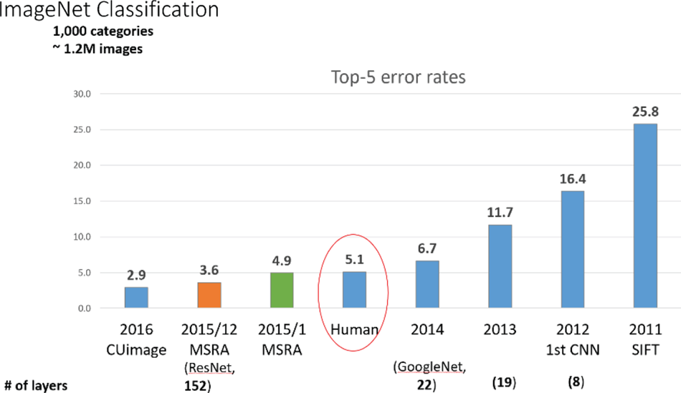
The Rise of Deep Learning
Success of deep learning on image classification

Slide 4
The Rise of Deep Learning
Many other applications
Vision: object detection, image generation
Language: machine translation, question answering
Gaming: Atari, Go, StarCraft, DOTA 2
Healthcare: drug discovery

Slide 5
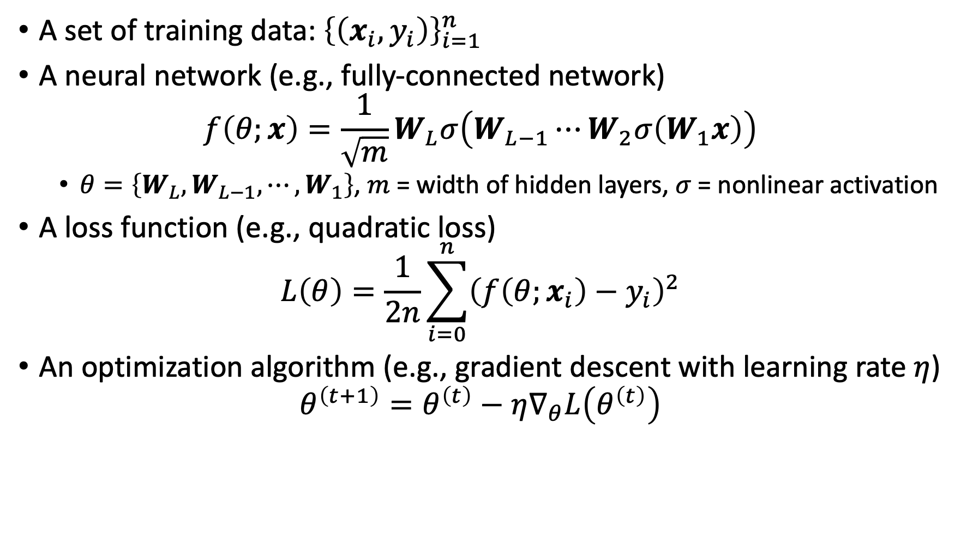
Deep Learning: Basics
A set of training data: ${\left\{\left(x_{i}, y_{i}\right)\right\}}_{i=1}^{n}$
A neural network (e.g., fully-connected network)
$$f\left(θ;x\right)=\frac{1}{\sqrt{m}}W_{L}σ\left(W_{L−1}⋯W_{2}σ\left(W_{1}x\right)\right)$$
$θ=\left\{W_{L},W_{L−1},⋯,W_{1}\right\}$, $m$ = width of hidden layers, $σ$ = nonlinear activation
A loss function (e.g., quadratic loss)
$$L\left(θ\right)=\frac{1}{2n}\sum_{i=0}^{n}{{\left(f\left(θ;x_{i}\right)−y_{i}\right)}^{2}}$$
An optimization algorithm (e.g., gradient descent with learning rate $η$)
$$θ^{\left(t+1\right)}=θ^{\left(t\right)}−η∇_{θ}L\left(θ^{\left(t\right)}\right)$$

Slide 6
Tricks in Applying Deep Learning
How wide?
How deep?
Which architecture?
Which optimization algorithm?
Which learning rate?
Which initialization method?
Keys: need to theoretically understand deep learning

Slide 7
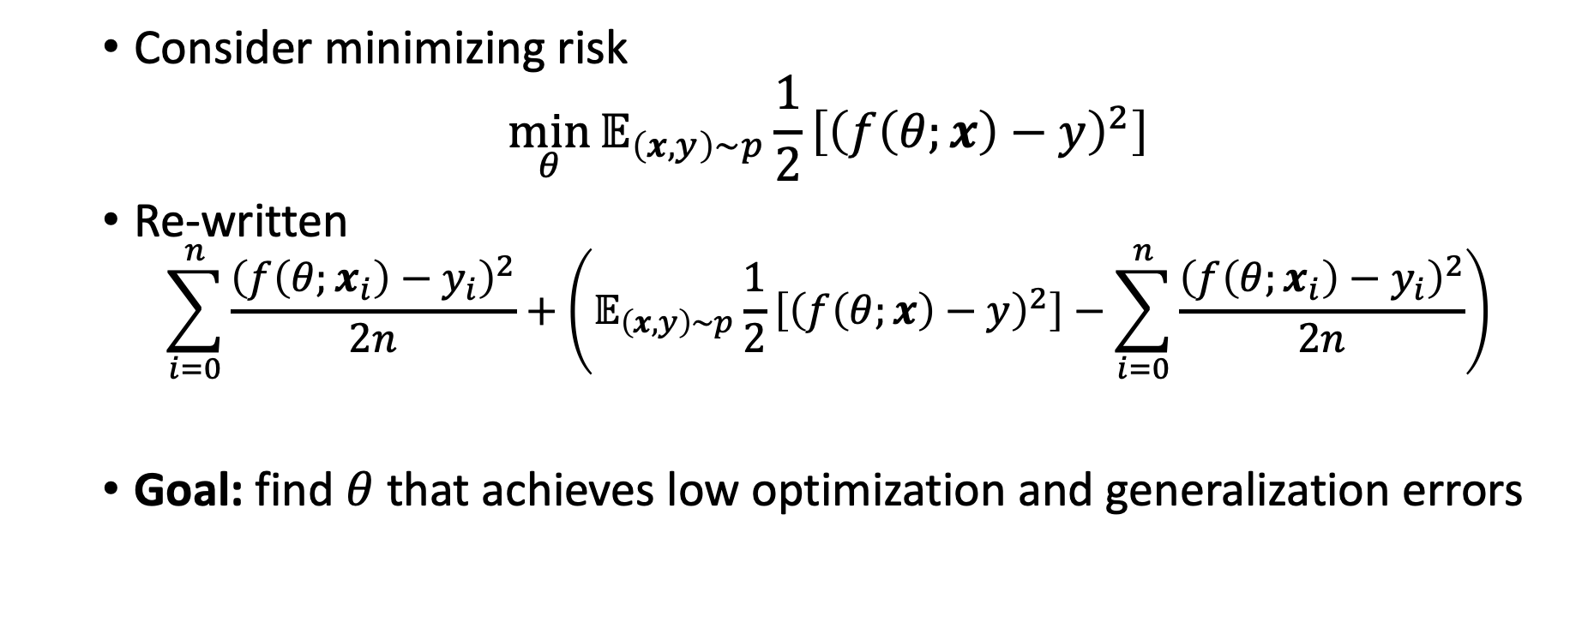
Understanding Deep Learning
Consider minimizing risk
$$\min_{θ}{𝔼_{\left(x,y\right)\sim p}\frac{1}{2}\left[{\left(f\left(θ;x\right)−y\right)}^{2}\right]}$$
Re-written
$$\sum_{i=0}^{n}{\frac{{\left(f\left(θ;x_{i}\right)−y_{i}\right)}^{2}}{2n}}+\left(𝔼_{\left(x,y\right)\sim p}\frac{1}{2}\left[{\left(f\left(θ;x\right)−y\right)}^{2}\right]−\sum_{i=0}^{n}{\frac{{\left(f\left(θ;x_{i}\right)−y_{i}\right)}^{2}}{2n}}\right)$$
Goal: find $θ$ that achieves low optimization and generalization errors
optimization error
generalization error

Slide 8
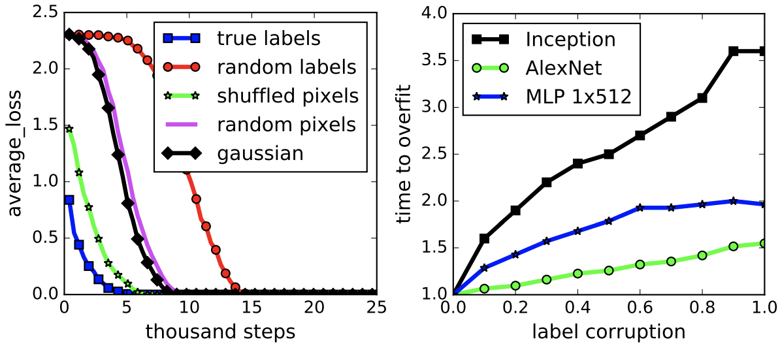
Deep Learning: Convergence
Observation: NNs can fit random data/data with random labels (Zhang et al., 2017)

Slide 9
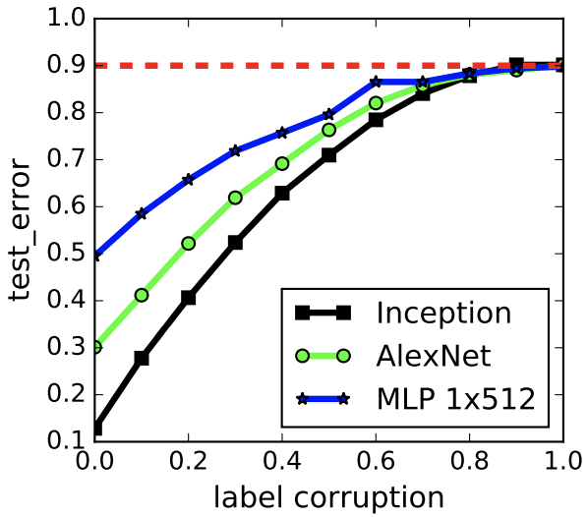
Deep Learning: Generalization
Observation: generalization error grows as level of label corruption increases (Zhang et al., 2017)

Slide 10
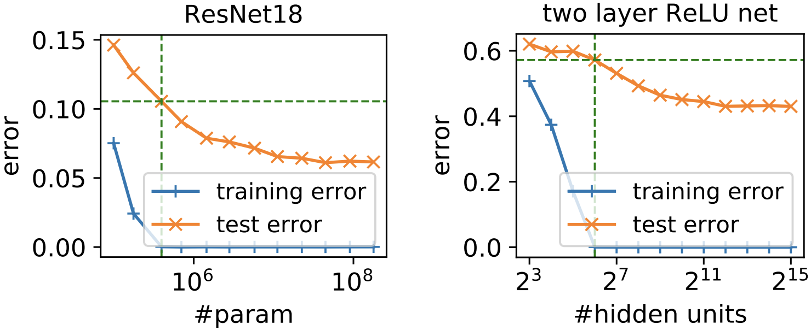
Deep Learning: Generalization
Observation: test error keeps decreasing when training error is 0 (Neyshabur et al., 2018)
Question: can we use classic techniques in traditional machine learning?

Slide 11
Over-Parameterization of Deep Learning
CIFAR10 | #train: ~50k
Inception | 1.6m+
AlexNet | 1.3m+
ImageNet | #train: ~1.2m
Inception V4 | 42m+
AlexNet | 61m+
VGG 11 | 132m+
VGG 19 | 143m+
ResNet 18 | 11m+
ResNet 152 | 60m+

Slide 12
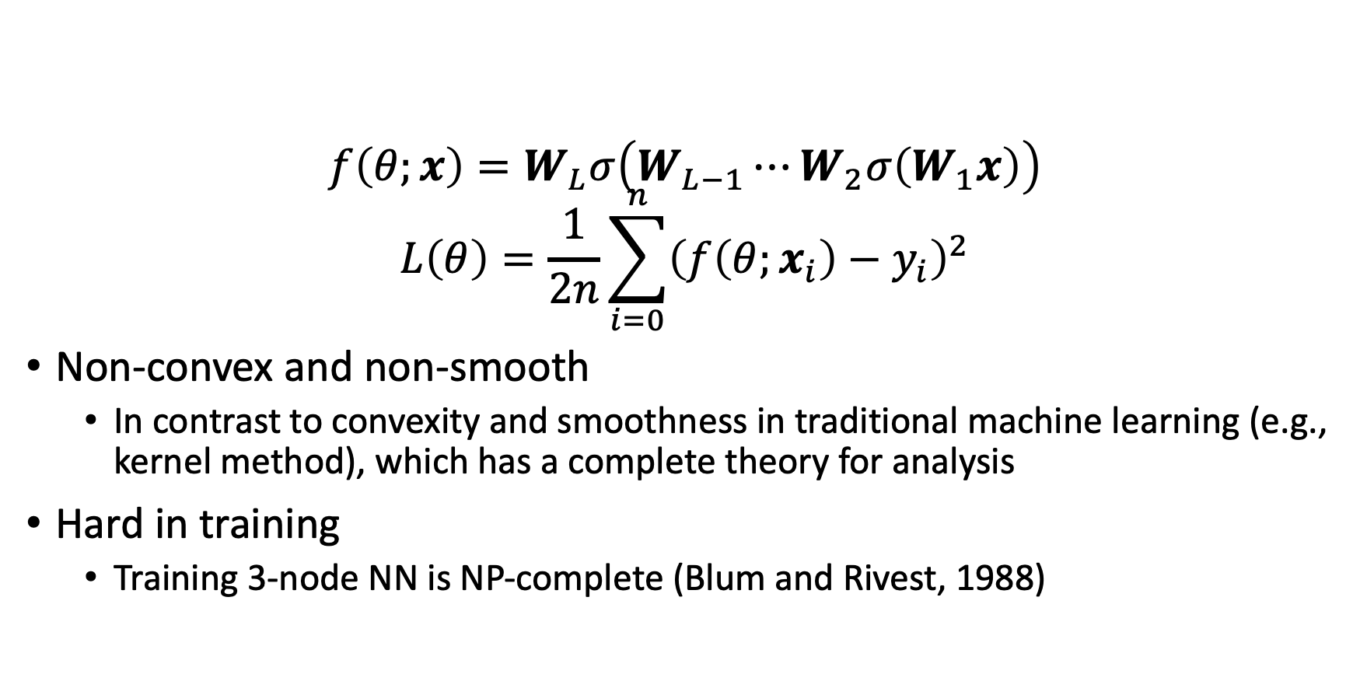
Challenges in Convergence
$$f\left(θ;x\right)=W_{L}σ\left(W_{L−1}⋯W_{2}σ\left(W_{1}x\right)\right)$$
$$L\left(θ\right)=\frac{1}{2n}\sum_{i=0}^{n}{{\left(f\left(θ;x_{i}\right)−y_{i}\right)}^{2}}$$
Non-convex and non-smooth
In contrast to convexity and smoothness in traditional machine learning (e.g., kernel method), which has a complete theory for analysis
Hard in training
Training 3-node NN is NP-complete (Blum and Rivest, 1988)

Slide 13
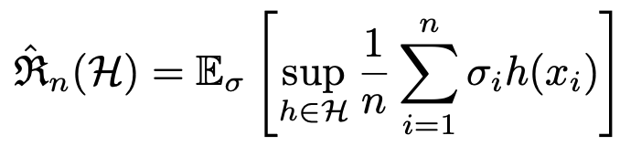
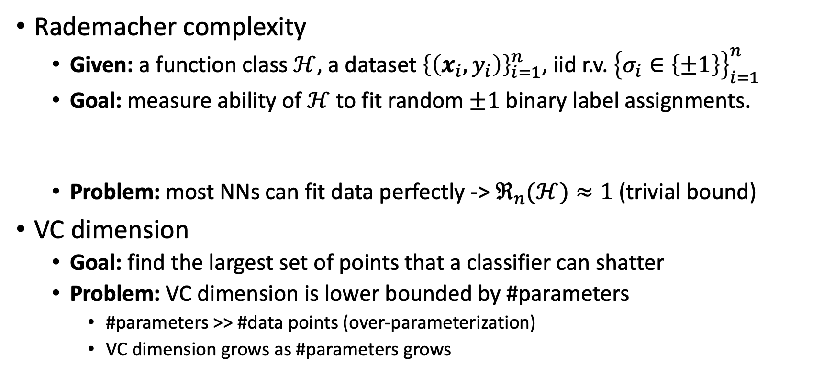
Challenges in Generalization
Rademacher complexity
Given: a function class $ℋ$, a dataset ${\left\{\left(x_{i}, y_{i}\right)\right\}}_{i=1}^{n}$, iid r.v. ${\left\{σ_{i}∈\left\{±1\right\}\right\}}_{i=1}^{n}$
Goal: measure ability of $ℋ$ to fit random $±1$ binary label assignments.
Problem: most NNs can fit data perfectly -> $ℜ_{n}(ℋ)≈1$ (trivial bound)
VC dimension
Goal: find the largest set of points that a classifier can shatter
Problem: VC dimension is lower bounded by #parameters
#parameters >> #data points (over-parameterization)
VC dimension grows as #parameters grows

Slide 14
Neural Tangent Kernel: What
Possible solution: neural tangent kernel (NTK)
What is NTK?
If a neural network is
sufficiently wide (e.g., infinite-width)
properly randomly initialized
trained by gradient flow (i.e., continuous time gradient descent, gradient descent with infinitesimal step size)
It is equivalent to a kernel regression predictor with a deterministic kernel named neural tangent kernel (NTK)

Slide 15
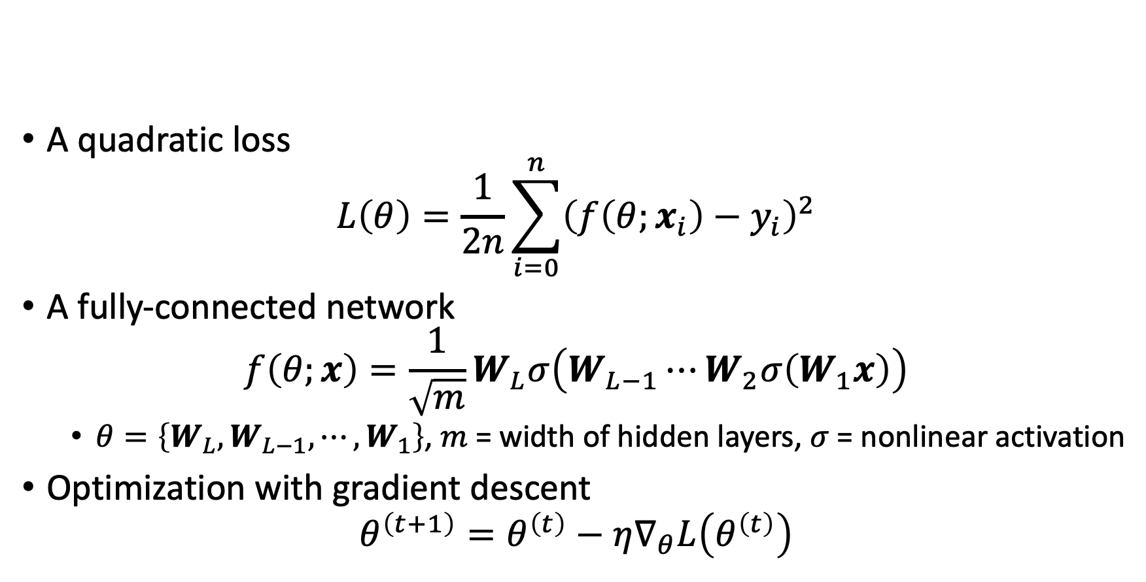
Problem Setting
A quadratic loss
$$L\left(θ\right)=\frac{1}{2n}\sum_{i=0}^{n}{{\left(f\left(θ;x_{i}\right)−y_{i}\right)}^{2}}$$
A fully-connected network
$$f\left(θ;x\right)=\frac{1}{\sqrt{m}}W_{L}σ\left(W_{L−1}⋯W_{2}σ\left(W_{1}x\right)\right)$$
$θ=\left\{W_{L},W_{L−1},⋯,W_{1}\right\}$, $m$ = width of hidden layers, $σ$ = nonlinear activation
Optimization with gradient descent
$$θ^{\left(t+1\right)}=θ^{\left(t\right)}−η∇_{θ}L\left(θ^{\left(t\right)}\right)$$

Slide 16
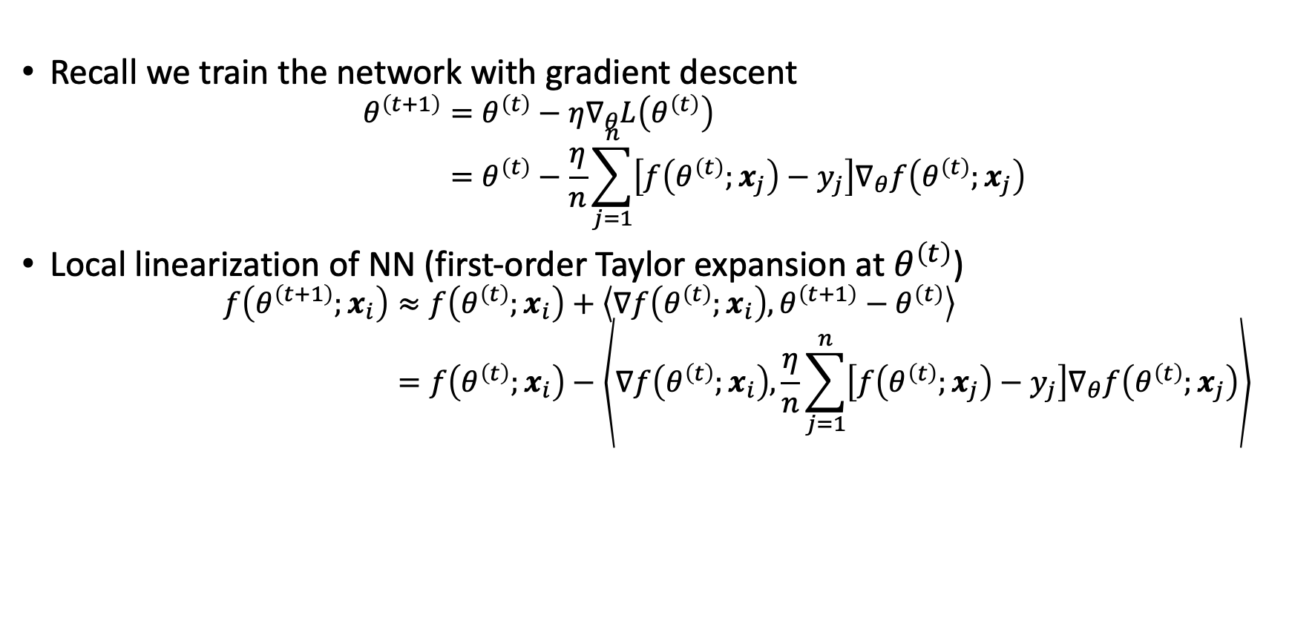
Deriving Neural Tangent Kernel
Recall we train the network with gradient descent
$$θ^{\left(t+1\right)}=θ^{\left(t\right)}−η∇_{θ}L\left(θ^{\left(t\right)}\right) \\ =θ^{\left(t\right)}−\frac{η}{n}\sum_{j=1}^{n}{\left[f\left(θ^{\left(t\right)};x_{j}\right)−y_{j}\right]∇_{θ}f\left(θ^{\left(t\right)};x_{j}\right)}$$
Local linearization of NN (first-order Taylor expansion at $θ^{\left(t\right)}$)
$$f\left(θ^{\left(t+1\right)};x_{i}\right)≈f\left(θ^{\left(t\right)};x_{i}\right)+\left\langle ∇f\left(θ^{\left(t\right)};x_{i}\right),θ^{\left(t+1\right)}−θ^{\left(t\right)}\right\rangle \\ =f\left(θ^{\left(t\right)};x_{i}\right)−\left\langle ∇f\left(θ^{\left(t\right)};x_{i}\right),\frac{η}{n}\sum_{j=1}^{n}{\left[f\left(θ^{\left(t\right)};x_{j}\right)−y_{j}\right]∇_{θ}f\left(θ^{\left(t\right)};x_{j}\right)}\right\rangle$$

Slide 17

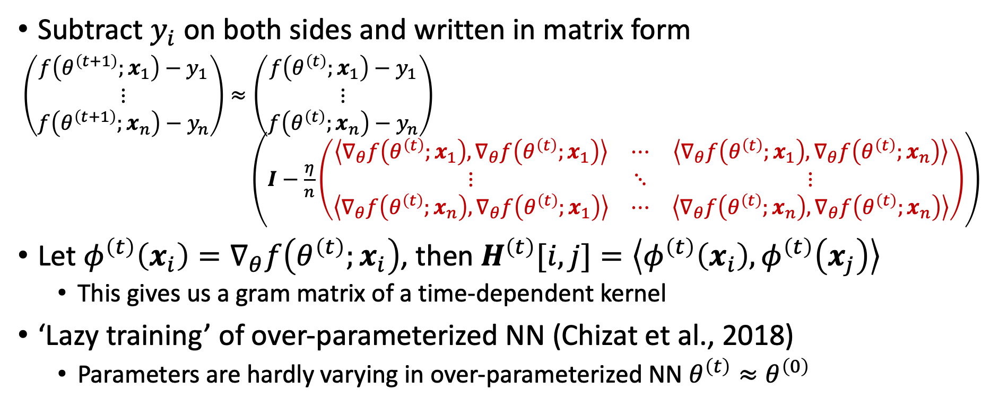
Deriving Neural Tangent Kernel
Subtract $y_{i}$ on both sides and written in matrix form
$\left(\begin{aligned}f\left(θ^{\left(t+1\right)};x_{1}\right)−y_{1} \\ ⋮ \\ f\left(θ^{\left(t+1\right)};x_{n}\right)−y_{n}\end{aligned}\right)≈\left(\begin{aligned}f\left(θ^{\left(t\right)};x_{1}\right)−y_{1} \\ ⋮ \\ f\left(θ^{\left(t\right)};x_{n}\right)−y_{n}\end{aligned}\right)$ $\left(I−\frac{η}{n}\left(\begin{matrix}\left\langle ∇_{θ}f\left(θ^{\left(t\right)};x_{1}\right),∇_{θ}f\left(θ^{\left(t\right)};x_{1}\right)\right\rangle & ⋯ & \left\langle ∇_{θ}f\left(θ^{\left(t\right)};x_{1}\right),∇_{θ}f\left(θ^{\left(t\right)};x_{n}\right)\right\rangle \\ ⋮ & ⋱ & ⋮ \\ \left\langle ∇_{θ}f\left(θ^{\left(t\right)};x_{n}\right),∇_{θ}f\left(θ^{\left(t\right)};x_{1}\right)\right\rangle & ⋯ & \left\langle ∇_{θ}f\left(θ^{\left(t\right)};x_{n}\right),∇_{θ}f\left(θ^{\left(t\right)};x_{n}\right)\right\rangle \end{matrix}\right)\right)$
Let $φ^{\left(t\right)}\left(x_{i}\right)=∇_{θ}f\left(θ^{\left(t\right)};x_{i}\right)$, then $H^{\left(t\right)}[i,j]=\left\langle φ^{\left(t\right)}\left(x_{i}\right),φ^{\left(t\right)}\left(x_{j}\right)\right\rangle$
This gives us a gram matrix of a time-dependent kernel
‘Lazy training’ of over-parameterized NN (Chizat et al., 2018)
Parameters are hardly varying in over-parameterized NN $θ^{\left(t\right)}≈θ^{\left(0\right)}$
$$H^{\left(t\right)}$$

Slide 18
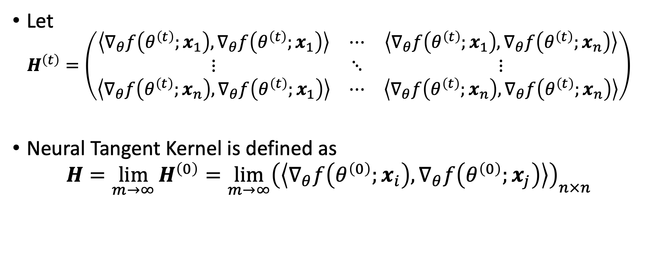
Neural Tangent Kernel: Definition
Let
$$H^{\left(t\right)}=\left(\begin{matrix}\left\langle ∇_{θ}f\left(θ^{\left(t\right)};x_{1}\right),∇_{θ}f\left(θ^{\left(t\right)};x_{1}\right)\right\rangle & ⋯ & \left\langle ∇_{θ}f\left(θ^{\left(t\right)};x_{1}\right),∇_{θ}f\left(θ^{\left(t\right)};x_{n}\right)\right\rangle \\ ⋮ & ⋱ & ⋮ \\ \left\langle ∇_{θ}f\left(θ^{\left(t\right)};x_{n}\right),∇_{θ}f\left(θ^{\left(t\right)};x_{1}\right)\right\rangle & ⋯ & \left\langle ∇_{θ}f\left(θ^{\left(t\right)};x_{n}\right),∇_{θ}f\left(θ^{\left(t\right)};x_{n}\right)\right\rangle \end{matrix}\right)$$
Neural Tangent Kernel is defined as
$$H=\lim_{m→∞}{H^{\left(0\right)}}=\lim_{m→∞}{{\left(\left\langle ∇_{θ}f\left(θ^{\left(0\right)};x_{i}\right),∇_{θ}f\left(θ^{\left(0\right)};x_{j}\right)\right\rangle \right)}_{n×n}}$$

Slide 19
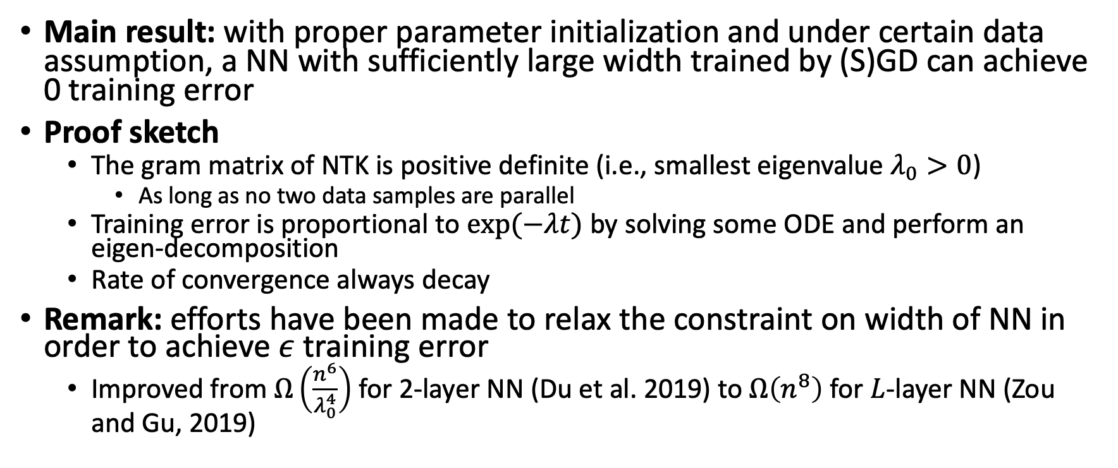
NTK Implication on Optimization
Main result: with proper parameter initialization and under certain data assumption, a NN with sufficiently large width trained by (S)GD can achieve 0 training error
Proof sketch
The gram matrix of NTK is positive definite (i.e., smallest eigenvalue $λ_{0}>0$)
As long as no two data samples are parallel
Training error is proportional to $exp⁡(−λt)$ by solving some ODE and perform an eigen-decomposition
Rate of convergence always decay
Remark: efforts have been made to relax the constraint on width of NN in order to achieve $ε$ training error
Improved from $Ω\left(\frac{n^{6}}{λ_{0}^{4}}\right)$ for 2-layer NN (Du et al. 2019) to $Ω\left(n^{8}\right)$ for $L$-layer NN (Zou and Gu, 2019)

Slide 20
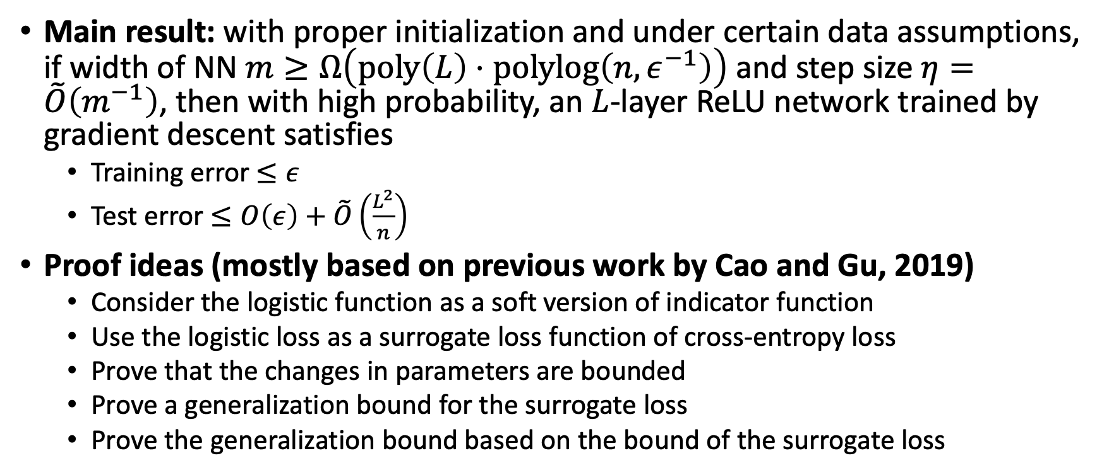
NTK Implication on Generalization
Main result: with proper initialization and under certain data assumptions, if width of NN $m≥Ω\left(poly\left(L\right)⋅polylog\left(n, ε^{−1}\right)\right)$ and step size $η=\tilde{O}\left(m^{−1}\right)$, then with high probability, an $L$-layer ReLU network trained by gradient descent satisfies
Training error $≤ε$
Test error $≤O\left(ε\right)+\tilde{O}\left(\frac{L^{2}}{n}\right)$
Proof ideas (mostly based on previous work by Cao and Gu, 2019)
Consider the logistic function as a soft version of indicator function
Use the logistic loss as a surrogate loss function of cross-entropy loss
Prove that the changes in parameters are bounded
Prove a generalization bound for the surrogate loss
Prove the generalization bound based on the bound of the surrogate loss

Slide 21
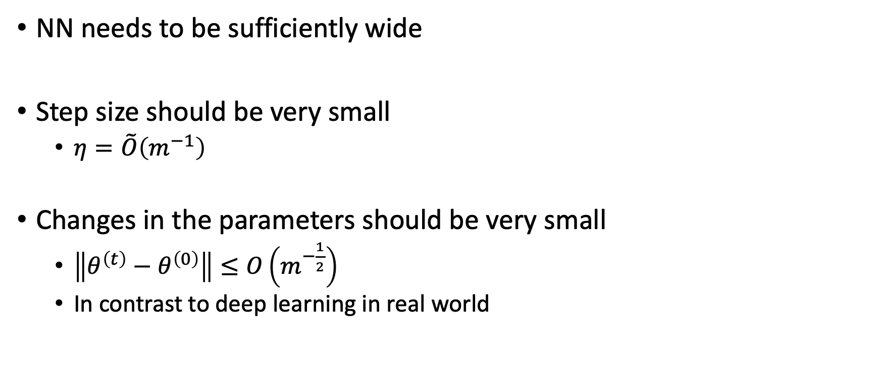
Limitations of NTK
NN needs to be sufficiently wide
Step size should be very small
$η=\tilde{O}\left(m^{−1}\right)$
Changes in the parameters should be very small
$\left\|θ^{\left(t\right)}−θ^{\left(0\right)}\right\|≤O\left(m^{−\frac{1}{2}}\right)$
In contrast to deep learning in real world

Slide 22
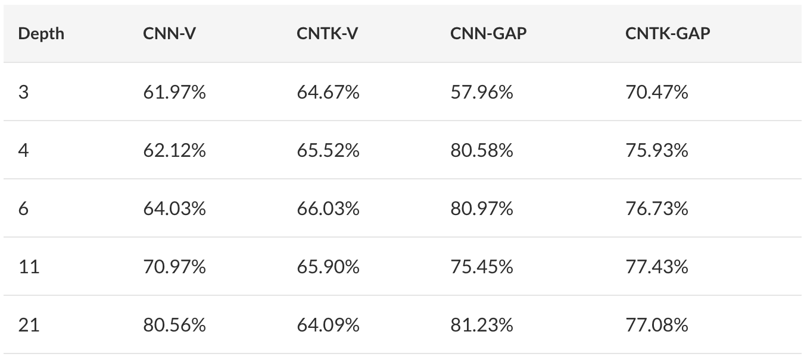
Neural Tangent Kernel: Applications
CNTK: NTK for convolutional neural networks (Du et al., 2019)
CNN/CNTK-V: vanilla CNN/CNTK
CNN/CNTK-GAP: CNN/CNTK with global average pooling

Slide 23
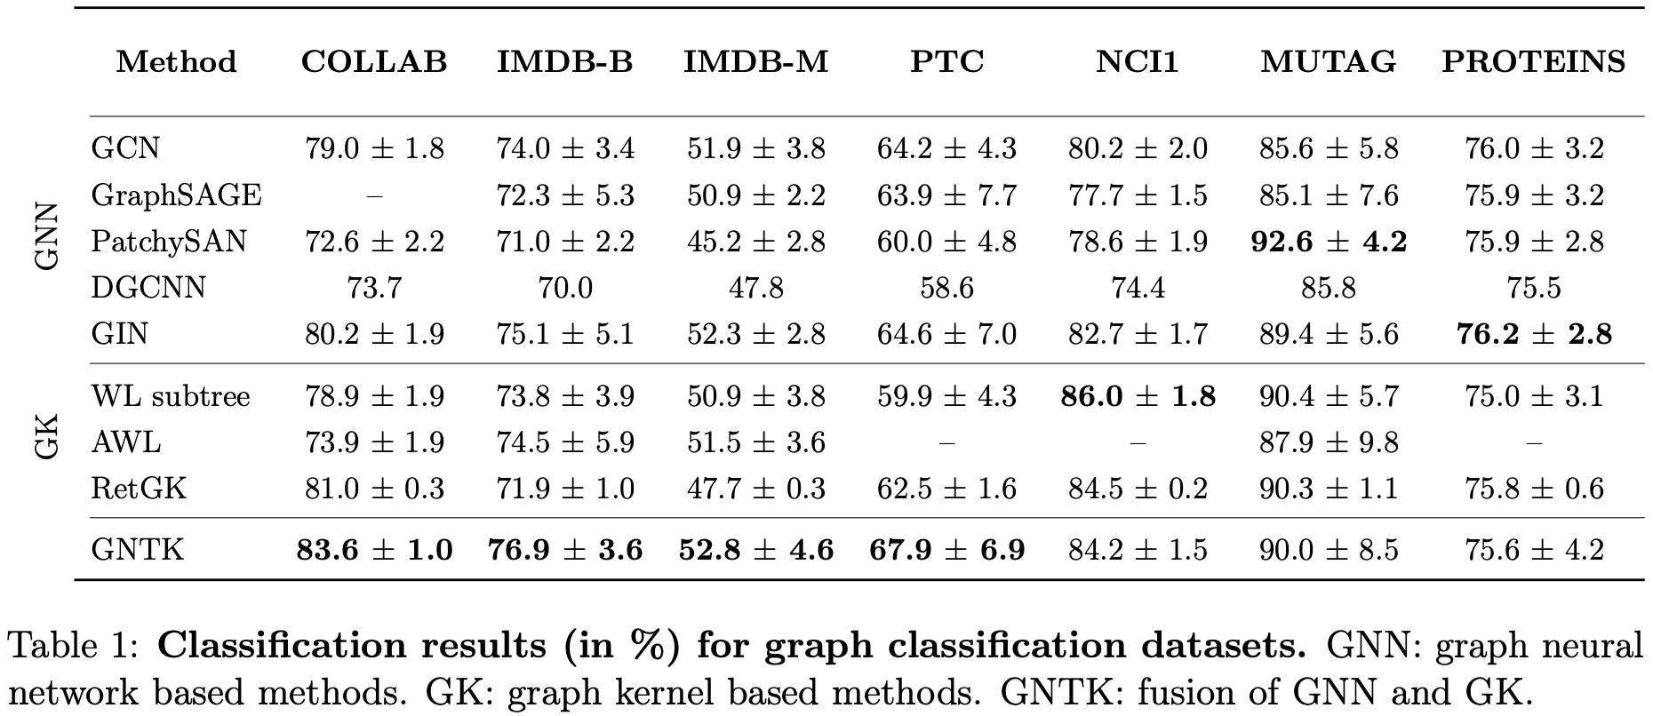
Neural Tangent Kernel: Applications
GNTK: NTK for graph neural networks (Du et al., 2019)

Slide 24
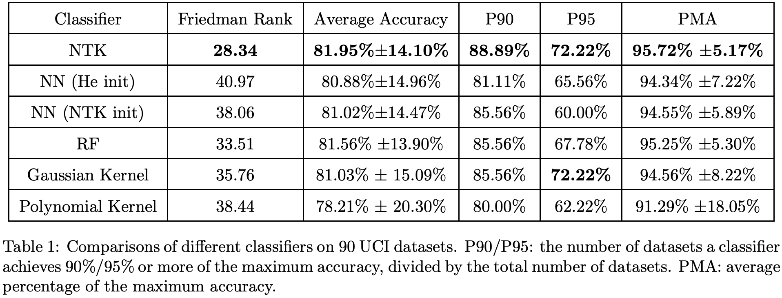
Neural Tangent Kernel: Applications
NTK on small UCI datasets (Arora et al., 2020)

Slide 25
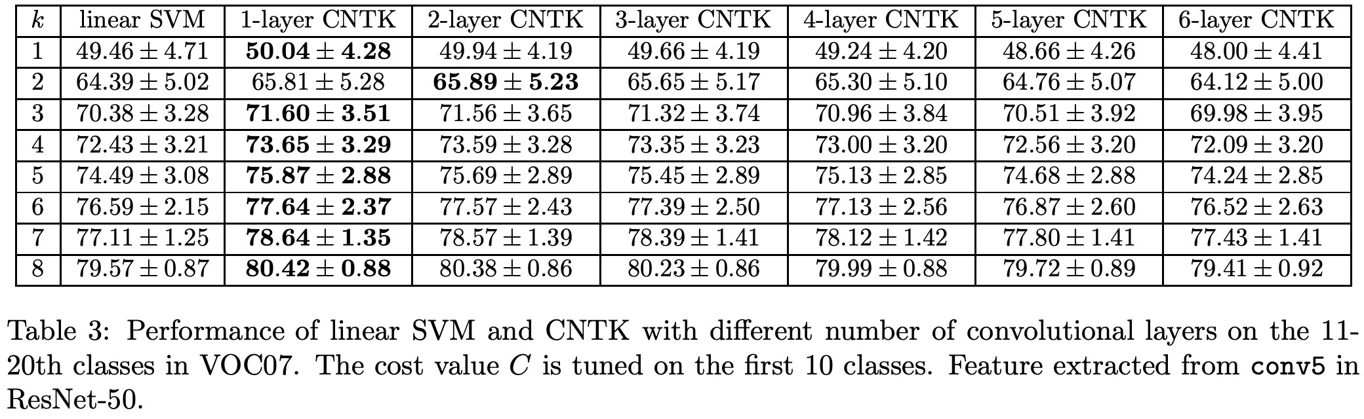
Neural Tangent Kernel: Applications
NTK for few-shot learning (Arora et al., 2020)

Slide 26
Takeaway Points
We need theoretical understanding of deep learning
Infinite-width network = NTK (under certain assumptions)
Under certain assumptions,
Deep NNs can converge to 0 training loss
Deep NNs can generalize
NTK is applicable to real-world applications (despite some limitations)
CNTK
GNTK
NTK for small data (UCI datasets, few-shot learning)

